Slide 1
Logic Grids as
Data Structures
Ryan Y. Batubara
0

Slide 2
What’s a logic grid?
1

Slide 3
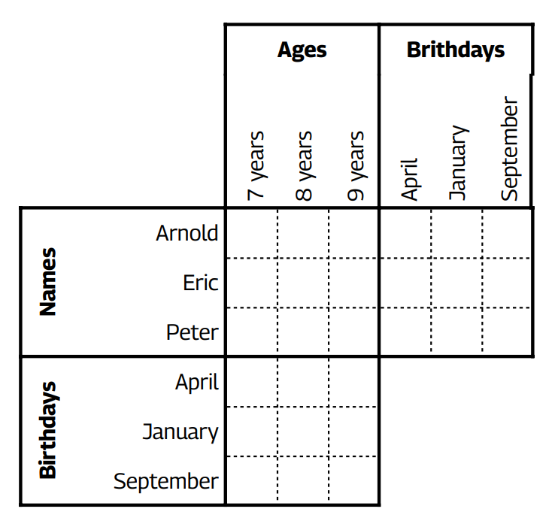
What’s a logic grid?
Peter's birthday is in April.
Eric is 7.
Arnold was born in September.
Peter is 8.
From Brainzilla Basic Logic Grid 1.
1

Slide 4
What’s a logic grid?
Peter's birthday is in April.
Eric is 7.
Arnold was born in September.
Peter is 8.
Arnold is 9, born in September.
Eric is 7, born in January.
Peter is 8, born in April.
From Brainzilla Basic Logic Grid 1.
1

Slide 5
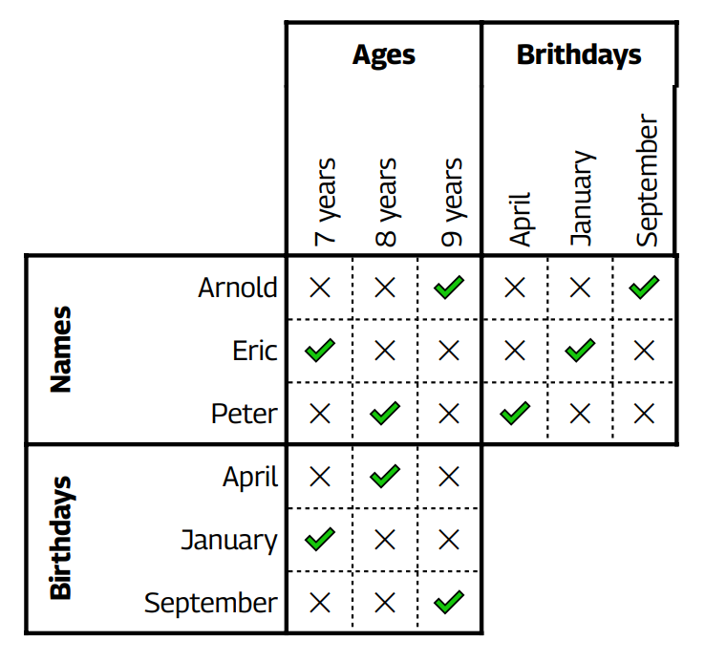
What’s a logic grid?
Logic grids (LGs) are puzzles where
You are given c categories, each with n distinct elements.
You are given clues about the categories and elements, leading to a unique bijection between categories.
1

Slide 6
So what?
Logic grids (with only simple* clues) are solvable in polynomial time w.r.t. # of categories and elements.
Also, many solvers can give provably correct human-like reasoning: https://arxiv.org/pdf/1910.06636
*only intuitionistic logic clues, and some other constraints.
1

Slide 7
So what?
Answers are also provably correct (in polynomial time).
If the puzzle has a unique solution, if your answer does not violate any of the clues or rules, it is correct.
Even without uniqueness, your answer is still correct if it never contradicts the clues & rules!
1

Slide 8
How about brute force?
If you have c categories each with n elements, there are
(n!)^{c-1}
>>exponential possible bijections, since
Fixing one category’s n elements, the first element has n choices to map into another category, the second n-1, and so on, so n! bijections between any two categories of equal size n.
Chain the categories one after another, repeating the above c-1 times.
1

Slide 9
Why polynomial?
There are a finite number of techniques* that can solve any logic grid:
True and False Clues
Multi-Elimination Clues
Neither/Nor Clues
Either/Or Clues
Greater/Lesser Than Clues
Unaligned Pair Clues
Transpositions
Parallel Cross Eliminations
Transitive Relationships (Either/Or)
Transitive Relationships (Unaligned Pair)
Comparative Relationships
Guided trial and error
Taking Notes
*and a polynomial upper bound on
the number of simple clues.
1

Slide 10
Useless logic grids?
So we have:
Polynomial-time solvers.
Explainable solvers.
Provably correct answers.
These are all very nice properties for a problem class to have.
1

Slide 11
Useless logic grids?
So we have:
Polynomial-time solvers.
Explainable solvers.
Provably correct answers.
These are all very nice properties for a problem class to have.
But it’s useless; You need:
All categories known & unique.
All elements known & unique.
All clues correct.
Non-contradicting clues.
Clues result in a solution. (Ideally unique solution too.)
You kind of already have the answer!
1

Slide 12
Useful LGs?
2

Slide 13
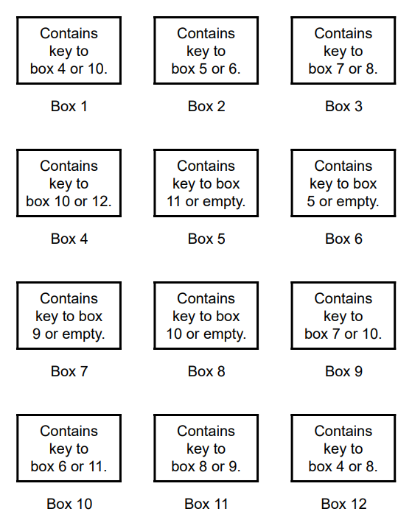
Key deductions
Logic grids have a lot of constraints, but they’re useful when the puzzle satisfies those constraints.
Even when the puzzle does not look like it can be solved as a logic grid.
Question: What’s the “hardest” part of this puzzle?
2

Slide 14
Key takeaways
When you have a problem encoded as a logic grid, you might as well say it’s trivially solvable.
A lot of the “difficulty” in applying logic grids comes from identifying or constructing the grid itself.
Puzzle from Return to Montague Island, puzzle 1.1.
2

Slide 15
Key solutions
“Box 4 must contain the key to box 12 since that key is found nowhere else. Since box 4 contains the key to box 12, box 12 cannot contain the key to box 4, since there would then be no way to open either box. Therefore, box 12 contains the key to box 8, which means that box 3 contains the key to box 7 and box 11 contains the key to box 9, which contains the key to box 10.”
Solution from Return to Montague Island, puzzle 1.1.
2

Slide 16
Key solutions
“If box 10 contained the key to box 11, the keys to boxes 9, 10, and 11 would all be within those same three boxes, and no other box would have a key to any of them. Therefore, box 10 contains the key to box 6 and box 2 contains the key to box 5. Since box 12 does not contain the key to box 4, box 1 does. The key to box 11 must be in box 5, and boxes 6, 7, and 8 have no keys.”
Solution from Return to Montague Island, puzzle 1.1.
2

Slide 17
Key solutions
“Starting with box 2 leads to boxes 5, 11, 9, 10, and 6, which is the sequence that uses the most keys, so the prize is in box 6. Starting with box 1 leads to boxes 4, 12, and 8. Starting with box 3 leads only to box 7.”
Solution from Return to Montague Island, puzzle 1.1.
2

Slide 18
Key solutions
“Box 1 contains the key to box 4.
Box 2 contains the key to box 5.
Box 3 contains the key to box 7.
Box 4 contains the key to box 12.
Box 5 contains the key to box 11.
Box 6 contains the prize.
Solution from Return to Montague Island, puzzle 1.1.
Box 7 is empty.
Box 8 is empty.
Box 9 contains the key to box 10.
Box 10 contains the key to box 6.
Box 11 contains the key to box 9.
Box 12 contains the key to box 8.”
2

Slide 19
Useless LGs?
3

Slide 20
Who’s the liar?
Fatima and Amara come from a land where some always tell the truth, and the rest always lie.
Amara says, “Either Fatima lies, or I am truthful.”
Are Fatima and/or Amara liars?
Usually we use a truth table, but can we use a logic grid?
3

Slide 21
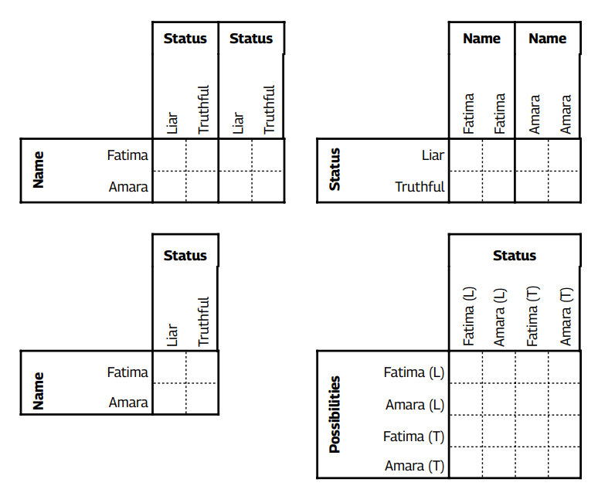
What’s the grid?
3

Slide 22
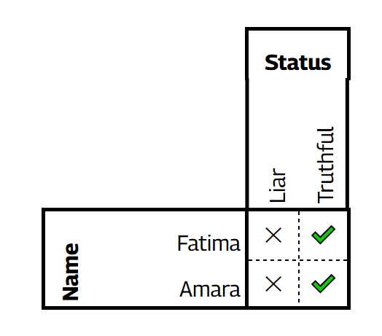
An impostor grid?
A solution exists, but it’s more work than a truth table, since we want unique categories in bijection.
So, truth tables ≠ logic grids.
But what if we allowed grids like the one on the left? Do logic grids still have nice properties?
Puzzle from Truth & Lies Generator.
3

Slide 23
Non-bijective LGs
4

Slide 24
Less useless logic grids
Recall logic grids need
All categories known & unique.
All elements known & unique.
All clues correct.
Non-contradicting clues.
Clues result in a solution. (Ideally unique solution too.)
4

Slide 25
Less useless logic grids
Recall logic grids need
All categories known & unique.
All elements known & unique.
All clues correct.
Non-contradicting clues.
Clues result in a solution. (Ideally unique solution too.)
We try to relax 1 and 2:
All categories known.
All elements known.
Any ideas of examples?
4

Slide 26
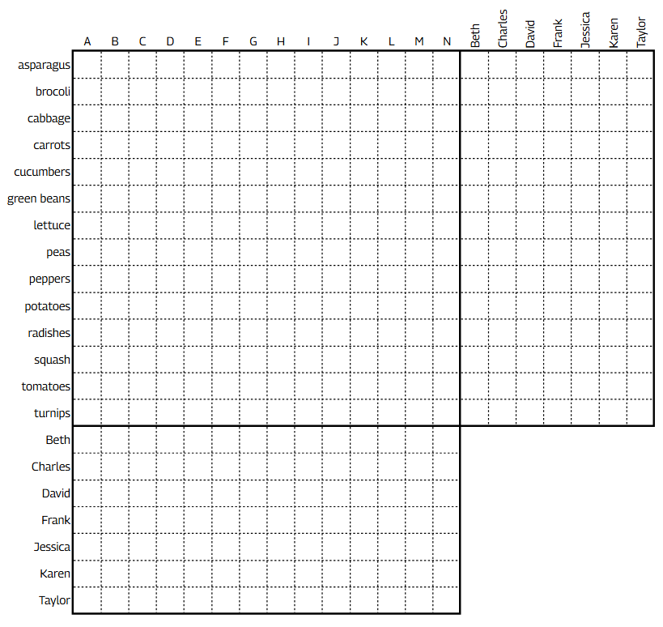
Garden plots
The bijective criterion is actually (somewhat) unnecessary!
Puzzle #4 (left) is an example that shows categories need not be the same size either.
Such grids remain provably correct and solvable in polynomial time.
4

Slide 27
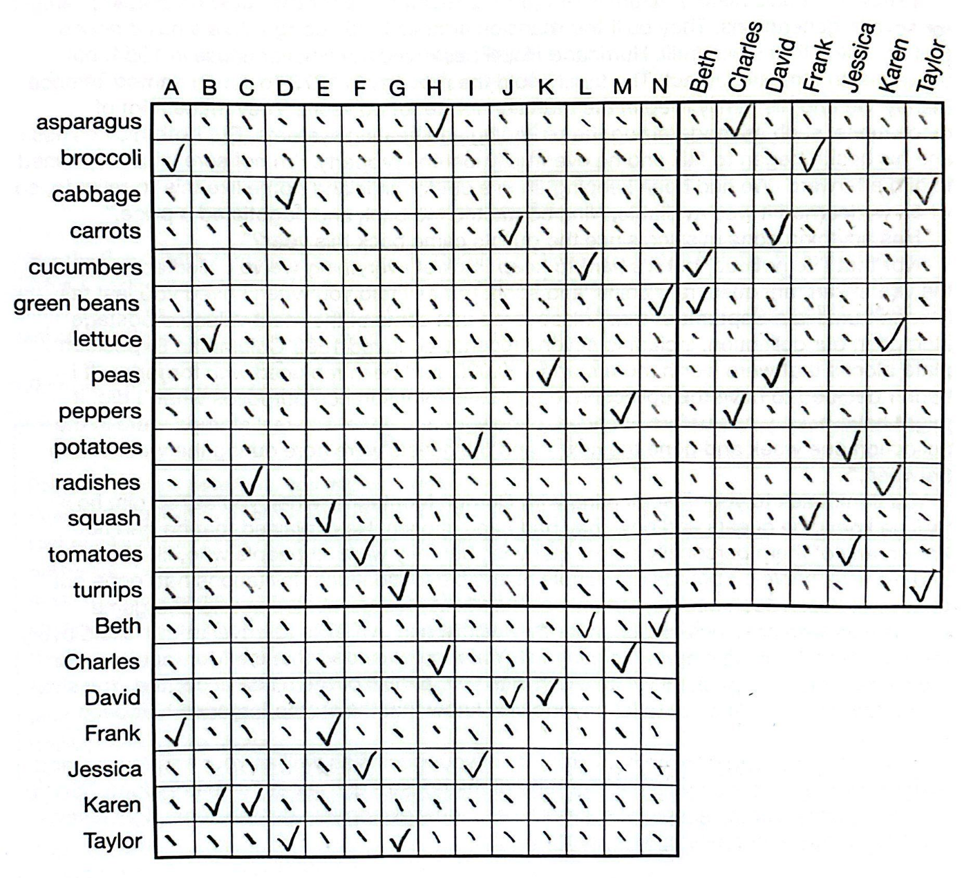
Garden plots
The double ticks in some columns may break some common tricks…
But the logic grid remains an incredibly effective way to encode information.
Puzzle from Montague Island Mysteries, puzzle 4.4.
4

Slide 28
Garden solutions
“From clues 2, 3, and 4, plots E, G, and H all border plots used by Charles, Frank, and Taylor. Since no plot borders all three of the plots E, G, and H, and no pair of adjacent plots—except for pairs that include E, G, or H—border all three of the plots E, G, and H, the guests who planted E, G, and H must be, in some order, Charles, Frank, and Taylor.”
Solution from Montague Island Mysteries, puzzle 4.4.
4

Slide 29
Garden solutions
“Since E borders both of Taylor’s plots, E cannot be Taylor’s plot. Each one of Jessica’s and Taylor’s plots border both E and H; those plots can only be F and G. Since Jessica’s plot is not G, hers must be F and Taylor’s must be G. Taylor’s other plot must be adjacent to both E and G, and so it must be D. Since H borders both of Jessica’s plots and her other plot must be adjacent to F, Jessica’s other plot must be I.”
Solution from Montague Island Mysteries, puzzle 4.4.
4

Slide 30
Garden solutions
“B and C must be used by the same guest, and from clue 2 that guest must be Karen. Both of David’s plots are adjacent to Taylor’s plot G, and so David’s plots must be J and K, since if they were K and L, J could not be adjacent to its user’s other plot. L must be the plot of Beth’s that G borders, and N is her other plot. Of Charles and Frank, one of them uses A and E and the other uses H and M.”
Solution from Montague Island Mysteries, puzzle 4.4.
4

Slide 31
Garden solutions
“Clues 6, 7, 8, and 9 identify four places in the garden where a pair of plots both border a pair of other plots and all four plots are used by different guests. From the garden diagram and the known ownership of the plots, these locations can only be, in some order: B and H both bordering E and F; E and H both bordering F and G; E and L both bordering G and H; and G and L both bordering H and K.”
Solution from Montague Island Mysteries, puzzle 4.4.
4

Slide 32
Garden solutions
“Only plot H comes up in all four sets of four plots, and so asparagus, which is mentioned in all four clues, is in plot H. The two vegetables mentioned only once in the four clues—lettuce and peas—must be in plots B and K, in some order. The two vegetables mentioned twice in the clues—cucumbers and tomatoes—must be in F and L some order. The two vegetables mentioned three times in the clues—squash and turnips—must be in E and G, in some order.”
Solution from Montague Island Mysteries, puzzle 4.4.
4

Slide 33
Garden solutions
“We know the four vegetables in the corner plots (clue 5), so by elimination, plots D, I, and M hold cabbage, peppers, and potatoes, in some order. From clue 10, peppers and potatoes border one another and must be in I and M, and so plot D contains cabbage. Plots I and M both border H, so H can’t be Frank’s (clue 10), which means Frank’s plots are A and E, and Charles’s are H and M. Green beans, one of the four corner plot vegetables (clue 5), borders peppers (clue 10), so must be in N.”
Solution from Montague Island Mysteries, puzzle 4.4.
4

Slide 34
Garden solutions
“n clue 11, the plot of Jessica’s that borders the corner plot radishes cannot be I, since N is green beans, and must be F, which means that I is potatoes, C is radishes, and M is peppers. Since David’s plots (J and K) do not contain broccoli or lettuce (clue 12), J contains carrots and K contains peas; by elimination, broccoli is in A and lettuce is in B. And since David’s plots do not border squash or tomatoes (clue 12), G contains turnips, L contains cucumbers, E contains squash, and F contains tomatoes.”
Solution from Montague Island Mysteries, puzzle 4.4.
4

Slide 35
Garden solutions
“Beth: plots L (cucumbers) and N (green beans)
Charles: plots H (asparagus) and M (peppers)
David: plots J (carrots) and K (peas)
Frank: plots A (broccoli) and E (squash)
Jessica: plots F (tomatoes) and I (potatoes)
Karen: plots B (lettuce) and C (radishes)
Taylor: plots D (cabbage) and G (turnips)”
Solution from Montague Island Mysteries, puzzle 4.4.
4

Slide 36
Lying LGs
5

Slide 37
Less useless logic grids
We now only need:
All categories known.
All elements known.
All clues correct.
Non-contradicting clues.
Clues result in a solution. (Ideally unique solution too.)
5

Slide 38
Much less useless LGs
We now only need:
All categories known.
All elements known.
All clues correct.
Non-contradicting clues.
Clues result in a solution. (Ideally unique solution too.)
We try to relax 3, 4, 5:
Clue may be incorrect, but it is known how many are incorrect.
Clues may contradict.
Clues may result in no solution, but there exists a subset of clues that result in a solution, satisfying >= # correct clues.
5

Slide 39
Murder mystery
A murder has occured! Alistair the butler is innocent, but one of the staff and one of guests are guilty!
Guilty statements can’t be trusted.
All other statements are true!
Who is the guilty staff member?
Who is the guilty guest?
5

Slide 40
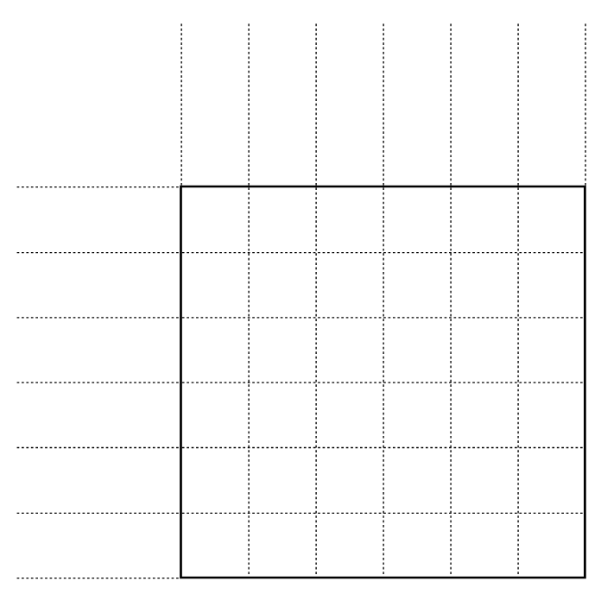
Murder mystery
A murder has occured! Alistair the butler is innocent, but one of the staff and one of guests are guilty!
Guilty statements can’t be trusted.
All other statements are true! Who is the guilty staff member and guest?
Puzzle from Montague Island Mysteries, puzzle 12.4.
5

Slide 41
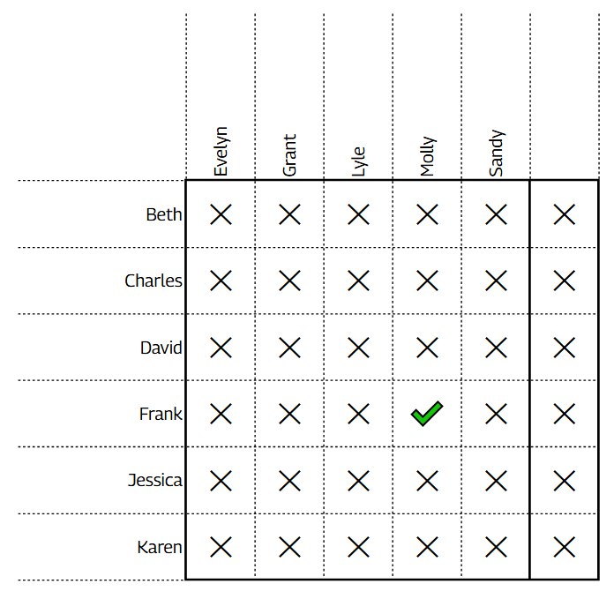
Grid mystery
If a statement is corroborated by two or more guests (or staff), it must be true.
Repeatedly applying this fact on guests, then staff, and then guests and staff again with newly gained information gives the solution.
?
5

Slide 42
Mystery solutions
“Molly and Frank are guilty. One solving method is to place an S in a box in the grid to indicate that a staff member has made a statement ruling out that pair, and to place a G in a box to indicate that a guest has made a statement ruling out that pair.”
Solution from Montague Island Mysteries, puzzle 12.4.
5

Slide 43
Mystery solutions
“Every pairing but one can be eliminated by statements from two staff members or by statements from two guests. The exception is Molly and Frank, each of whose statements eliminates the Molly–Frank pairing but is never corroborated by anyone else. They must be the guilty pair.”
Solution from Montague Island Mysteries, puzzle 12.4.
5

Slide 44
Mystery solutions
“Alternatively, consider all possible pairs of accomplices consisting of a staff member and a guest. Since Alistair can be trusted, his statement eliminates the possible pairs Evelyn–Jessica and Sandy–Jessica as being accomplices. The other statements by staff and guests eliminate various possibilities, but without certainty since any individual could be lying.”
Solution from Montague Island Mysteries, puzzle 12.4.
5

Slide 45
Mystery solutions
“But since only one staff member and one guest are guilty, corroboration of a fact by two staff members or by two guests is sufficient to confirm a fact. So, for example, when Evelyn says, “If Beth is guilty, then so is either Grant or Lyle,” the pairings Beth–Evelyn, Beth–Molly, and Beth–Sandy can be partially eliminated, subject to corroboration by another staff member.”
Solution from Montague Island Mysteries, puzzle 12.4.
5

Slide 46
Murder no mystery
We can generalize the technique; If there are k liars in a category, find all claims corroborated by k+1 claims in the category.
Repeat this for each category. Afterwards, do it again taking the new information into account until a solution is found.
Question: What if the number of liars is unknown?
5

Slide 47
Bounded lying LGs
6

Slide 48
Far less useless LGs
We now only need:
All categories known.
All elements known.
Clue may be incorrect, but it is known how many are incorrect.
Clues may contradict.
Clues may result in no solution, but there exists a subset of clues that result in a solution, satisfying >= # correct clues.
Let’s try to relax 3 further:
Clue may be incorrect, but there is a non-maximal bound on how many are incorrect.
6

Slide 49
Pilfer puzzle
A robbery has occurred in the same mansion! Fewer than 4 guests were the thieves. Their statements may be true or false. All other statements are true!
Police investigation has also shown that neither Danny nor Brianna makes a true statement unless he or she is innocent.
6

Slide 50
Pilfer puzzle
A robbery has occurred in the same mansion! Fewer than 4 guests were the thieves. Their statements may be true or false. All other statements are true!
Police investigation has also shown that neither Danny nor Brianna makes a true statement unless he or she is innocent.
Hints:
There is a fast way to find out the # of thieves.
Start with Danny and Brianna’s clues first.
At least one of the thieves is not lying; this thief must be identified through elimination.
6

Slide 51
Pilfer puzzle
There are 3 thieves, else there are more false statements than thieves.
Aria: Either Brianna or Cheryl is guilty, but not both.
Brianna: Cheryl is innocent, and there were three thieves.
Cheryl: Steven is innocent, and there were three thieves.
Danny: Either Kelly or Steven is guilty, but not both.
Kelly: I am innocent, and there were two thieves.
Steven: I am innocent, and there were three thieves.
Taylor: Either Aria or Danny is lying, but not both.
6

Slide 52
Pilfer solutions
“Aria, Kelly, and Taylor are the thieves. Taylor’s statement is true, but Aria’s and Kelly’s are false. Per clue 1, there were fewer than four thieves. If there were one or two thieves, there would be more false statements than thieves, which is impossible, so there were three thieves, and Kelly’s statement is false and she is guilty.”
Solution from Beyond Montague Island, puzzle 9.1.
6

Slide 53
Pilfer solutions
“If Danny’s statement is false, then Kelly and Steven are both lying. (It is possible for a guilty party to tell the truth, but Steven claims to be innocent, so if he’s guilty, then he’s lying.) In that case, Danny, Kelly, and Steven would all be guilty, but then impossible for everyone else to be innocent and telling the truth (in fact, in this hypothetical, they would all have to be lying), so Danny’s statement is true (and he is innocent, per clue 2), and Steven is innocent and telling the truth, which means Cheryl is telling the truth.”
Solution from Beyond Montague Island, puzzle 9.1.
6

Slide 54
Pilfer solutions
“If Aria’s statement is true, either Brianna or Cheryl is guilty and the other is innocent. If Brianna is the guilty one, then Brianna’s statement is true, but she can’t make a true statement unless she is innocent (clue 2), so this is impossible. If Cheryl is the guilty one, then Brianna’s statement is a lie, which means Brianna would also be guilty, which is a contradiction. Aria’s statement, then, must be false, and she is guilty.”
Solution from Beyond Montague Island, puzzle 9.1.
6

Slide 55
Pilfer solutions
“For Aria’s statement to be false, Brianna and Cheryl must either be both guilty or both innocent. If they are both guilty, then there would be four guilty guests, contradicting clue 1, so they are both innocent. By elimination, Taylor must be guilty of being the remaining thief despite making a true statement.”
Solution from Beyond Montague Island, puzzle 9.1.
6

Slide 56
Pilfer technique
Notice what we just did; our first instinct was to map the problem into an LG class we have seen.
Then, we focus on elements where we are more informed: Danny and Brianna, if guilty, must be liars.
Puzzle from Beyond Montague Island, puzzle 9.1.
Hints:
There is a fast way to find out the # of thieves.
Start with Danny and Brianna’s clues first.
At least one of the thieves is not lying; this thief must be identified through elimination.
6

Slide 57
Conclusions
7

Slide 58
Meta-solving
We started from a constrained problem, and then generalized:
Bijective LGs → Non-bijective LGs → Lying LGs → Bounded lying LGs
Similar to induction or bottom-up software development.
In doing so, we found a relatively powerful puzzle-solving algorithm, or more loosely, a framework for organizing puzzle-esque information.
7

Slide 59
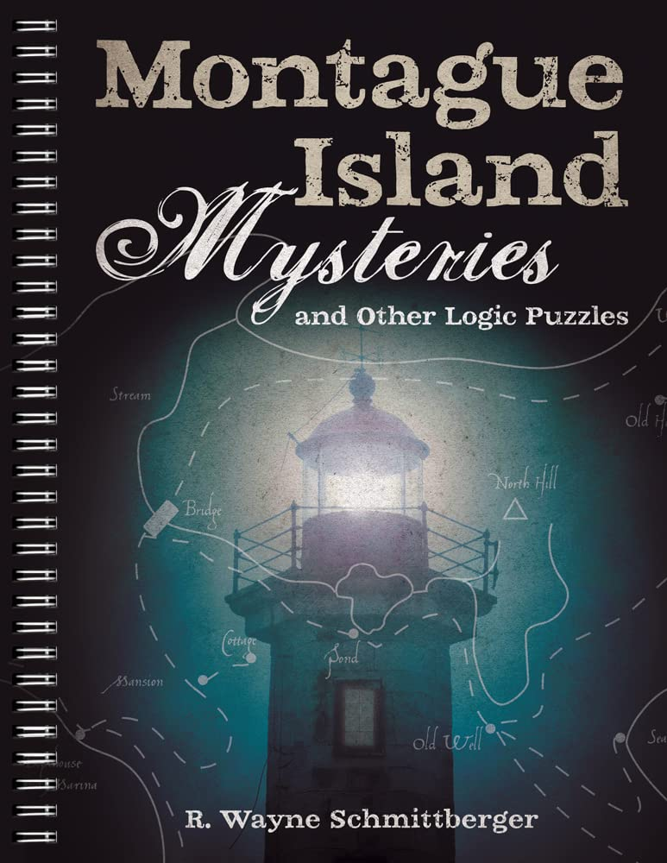
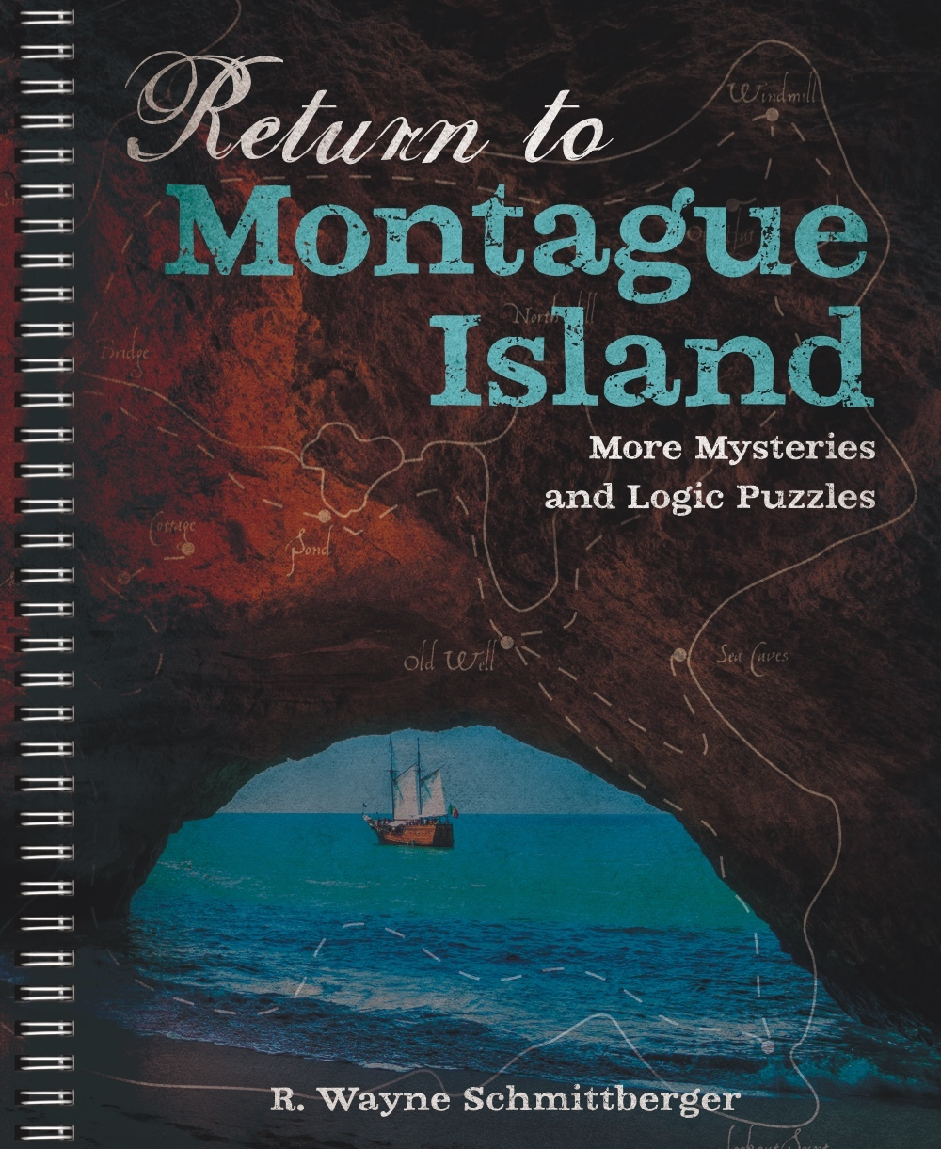
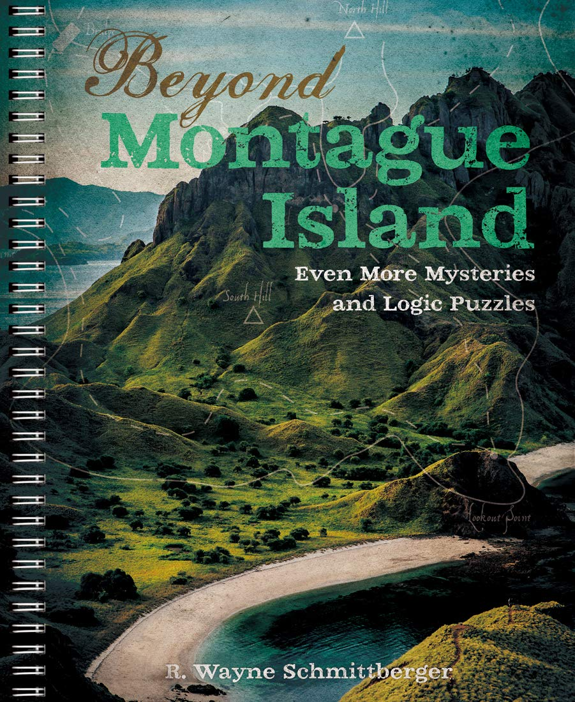
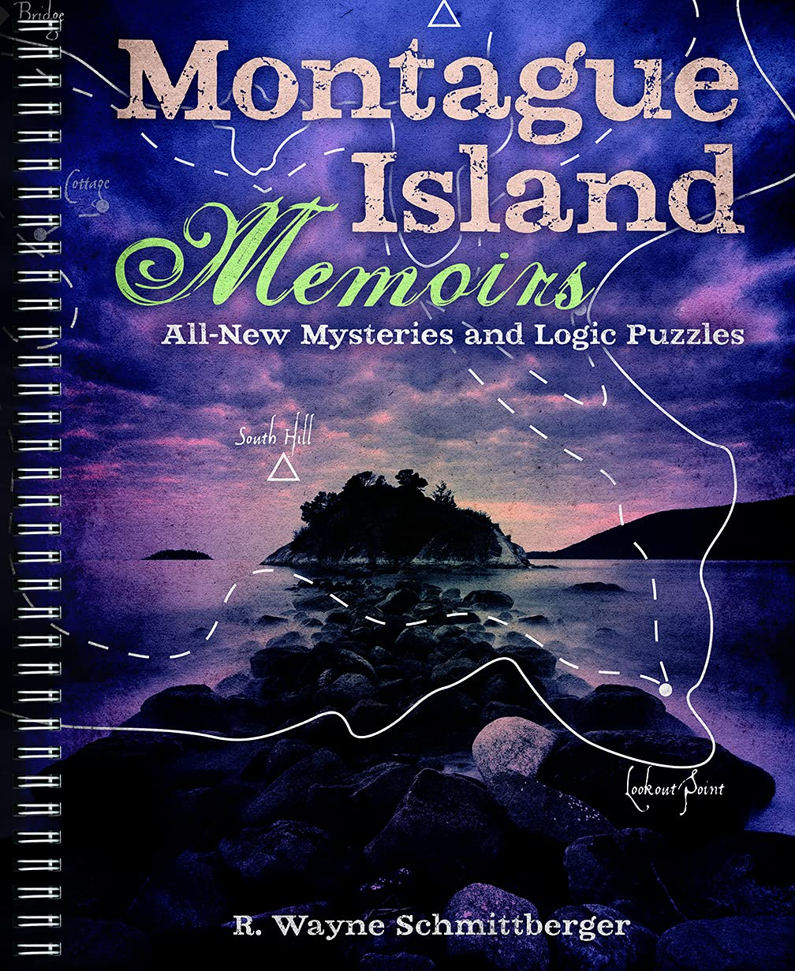
Montague-resources
Many of the puzzles in this talk are from the following books. If you enjoyed them (I certainly do!), I highly recommend getting a copy.
I'm not sponsored and sadly, the author is no longer with us.
7

Slide 60
Bonus: frame-up
Almost a Sherlock-Holmes story…
All clues are statements about what people did, and the solution not only identifies the murderer, but also how they did it, who they corroborated with, and when and where the murder took place!
Hint: Uses all the techniques from this talk.
7

Slide 61
Bonus solution
“Amanda and Dawn are guilty. Hoping to frame Henry for Sandy’s
murder, Dawn put the typewritten notes under the doors of Henry
and Lee while they were still at breakfast. Dawn also took the
letter opener from Henry’s room and moved it to Amanda’s room
after Henry and Lee had left the mansion. Amanda committed
the murder after sailing to the windmill and reaching the old hut
before Sandy did.”
Solution from Montague Island Memoirs, puzzle 8.2.
7

Slide 62
Bonus solution
“Since the statements of Amanda and Madison cannot both be true,
one of them is guilty. But since neither of them was in the mansion
during the time Henry and Lee (at most one of whom can be
lying, per Nina) claim to have had notes passed under their doors,
someone else who was in the mansion was an accomplice.”
Solution from Montague Island Memoirs, puzzle 8.2.
7

Slide 63
Bonus solution
“As his statement indicates, Henry’s room is on the second floor.
Since Thomas did not use the stairs (per Charlotte’s statement), he
could not have put the notes under Henry’s and Lee’s doors. Only
Dawn had an opportunity to do so between 8:15 and 8:30.”
“From Grant’s statement, Dawn and Madison cannot both be guilty,
so Amanda was the killer.”
Solution from Montague Island Memoirs, puzzle 8.2.
7

Slide 64
thank you!
∞

